Slide 1

Note: The data and information in this document is reflective of a hypothetical situation and client. This document is to be used for KPMG Virtual Internship purposes only.
Sprocket Central Pty Ltd
Data analytics approach
Rohit Bhalerao

Slide 2
Note: The data and information in this document is reflective of a hypothetical situation and client. This document is to be used for KPMG Virtual Internship purposes only.
Agenda
Introduction
Data Exploration
Model Development
Interpretation

Slide 3
Note: The data and information in this document is reflective of a hypothetical situation and client. This document is to be used for KPMG Virtual Internship purposes only.
Introduction
New customers analyses:
Look into these factors in new customers:
Age distributions
Number of bike purchases in 3 years / percentages purchases
Job industry category.
Wealth segments
Number of cars own on each states.

Slide 4
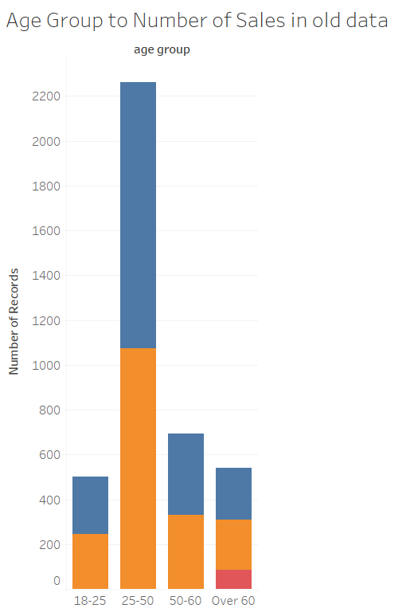
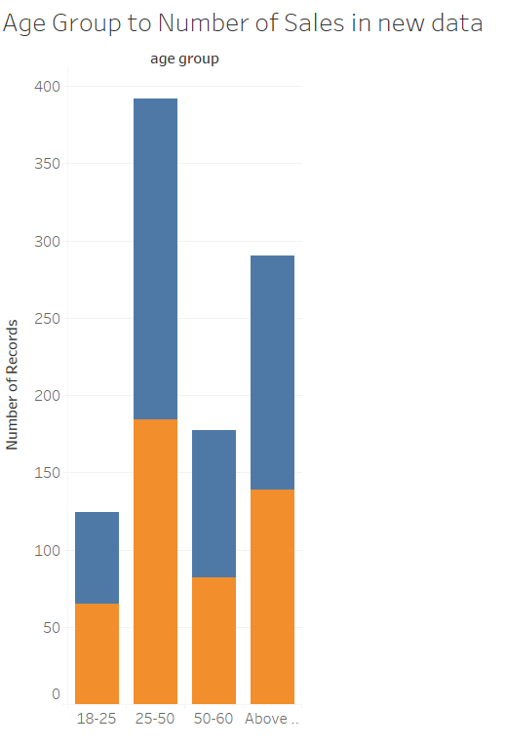
Note: The data and information in this document is reflective of a hypothetical situation and client. This document is to be used for KPMG Virtual Internship purposes only.
Data Exploration
Customers’ age distribution
New
As we can see, mostly our new customers are between 25 to 48 years old.
Number of customers from 48 to 59 years old has big drops on percentages.
There is a slightly increase in number of customers over 59 years old in term of percentages
It looks like the percentages of under 25 years old not really change.
Old

Slide 5
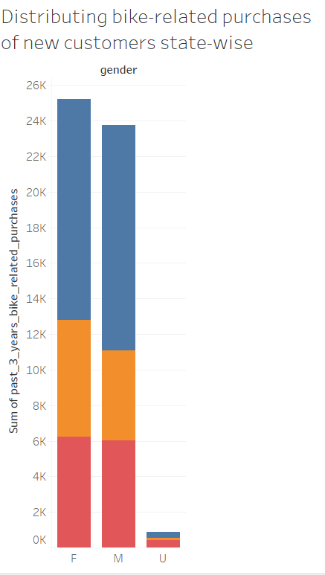
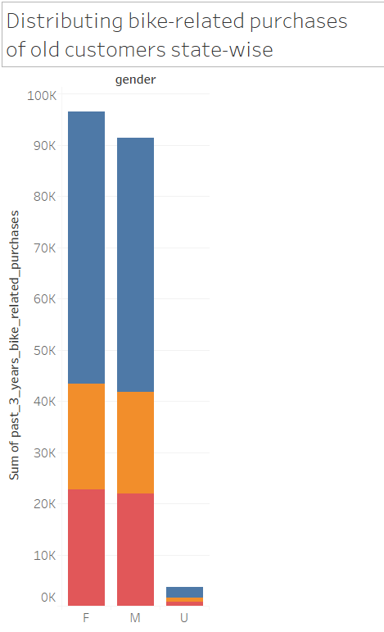
Note: The data and information in this document is reflective of a hypothetical situation and client. This document is to be used for KPMG Virtual Internship purposes only.
Model Development
Bike purchases last 3 years
As we can see, our new customers mostly Female with 50.6% purchases with total of 25,212 bikes
Male contributed to 47.7% purchases with 23,765 bikes
So we should focus on advertises on Female customers than Male customers

Slide 6
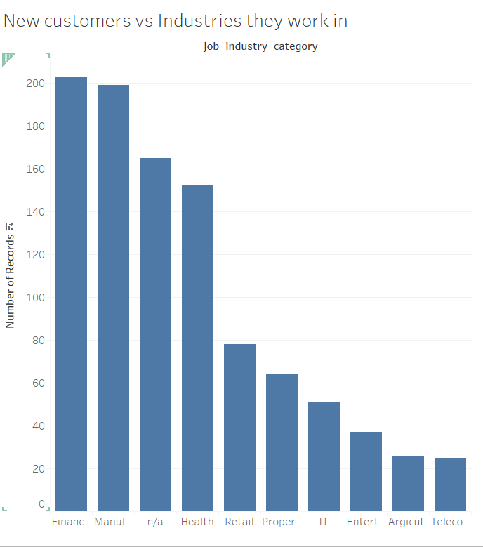
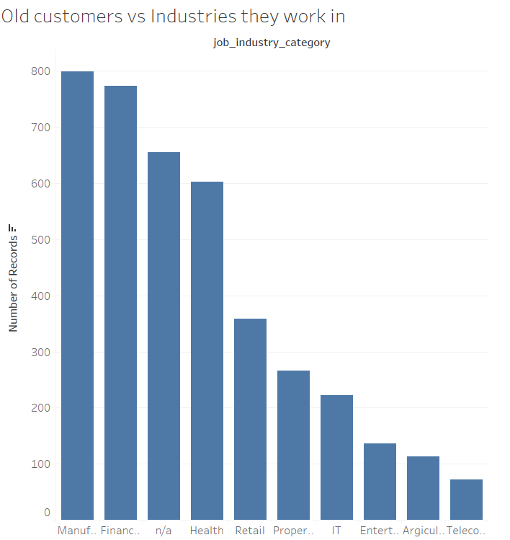
Note: The data and information in this document is reflective of a hypothetical situation and client. This document is to be used for KPMG Virtual Internship purposes only.
Interpretation
Job industry category.
Mostly our new customers are on Finance industry and our Manufacturing customers are still on top 2.
The rest industries is still same

Slide 7
Note: The data and information in this document is reflective of a hypothetical situation and client. This document is to be used for KPMG Virtual Internship purposes only.
Interpretation
Interpretations between historic data of old customers and new prospective customers show a similar trend in the number of customers aged betweed 25-50 and working in the Manufacturing and Finance industries .
Moreover, Females showed a higher chance of bike-related purchases in the last 3 years than men.
Females in the age group 25-50 in the Marketing or Finance industries in the new dataset should be best bet to market the new online services for optimal maximizing profits, followed by men. The new dataset also includes a huge growth in potential customers above the age 50-60 but this has no corresponding results in the previous customers data set and shows no reason to improve sales.

Slide 8
Note: The data and information in this document is reflective of a hypothetical situation and client. This document is to be used for KPMG Virtual Internship purposes only.
Appendix

